Slide 1


Slide 2
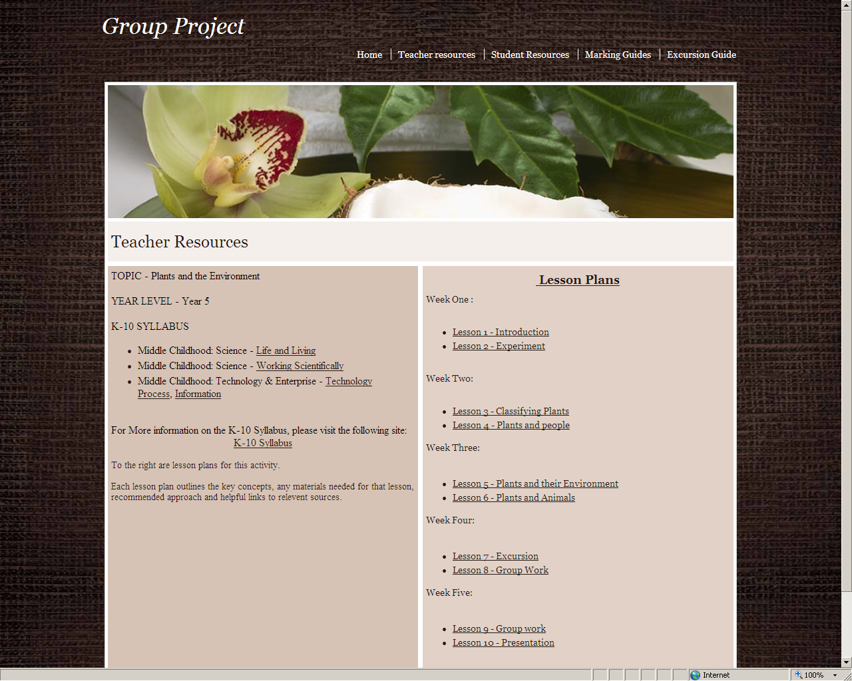

Slide 3
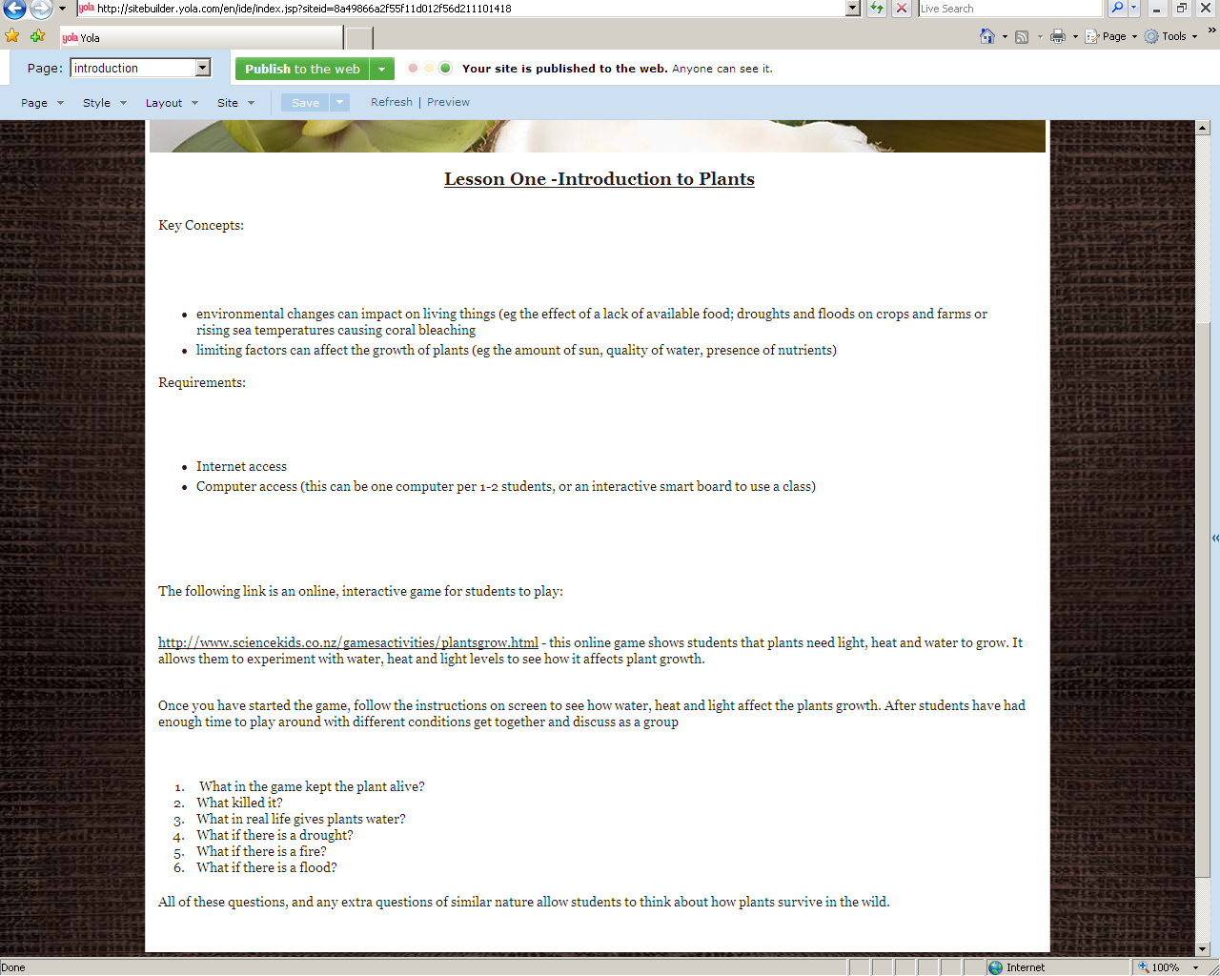

Slide 4
http://www.sciencekids.co.nz/gamesactivities/plantsgrow.html

Slide 5
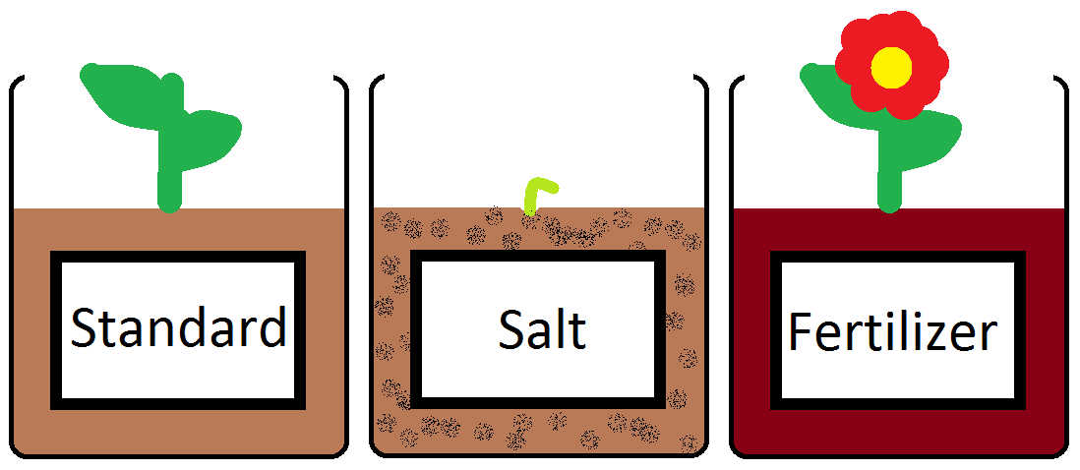

Slide 6


Slide 7
http://www.youtube.com/watch?v=FLVMHcokVNs

Slide 8
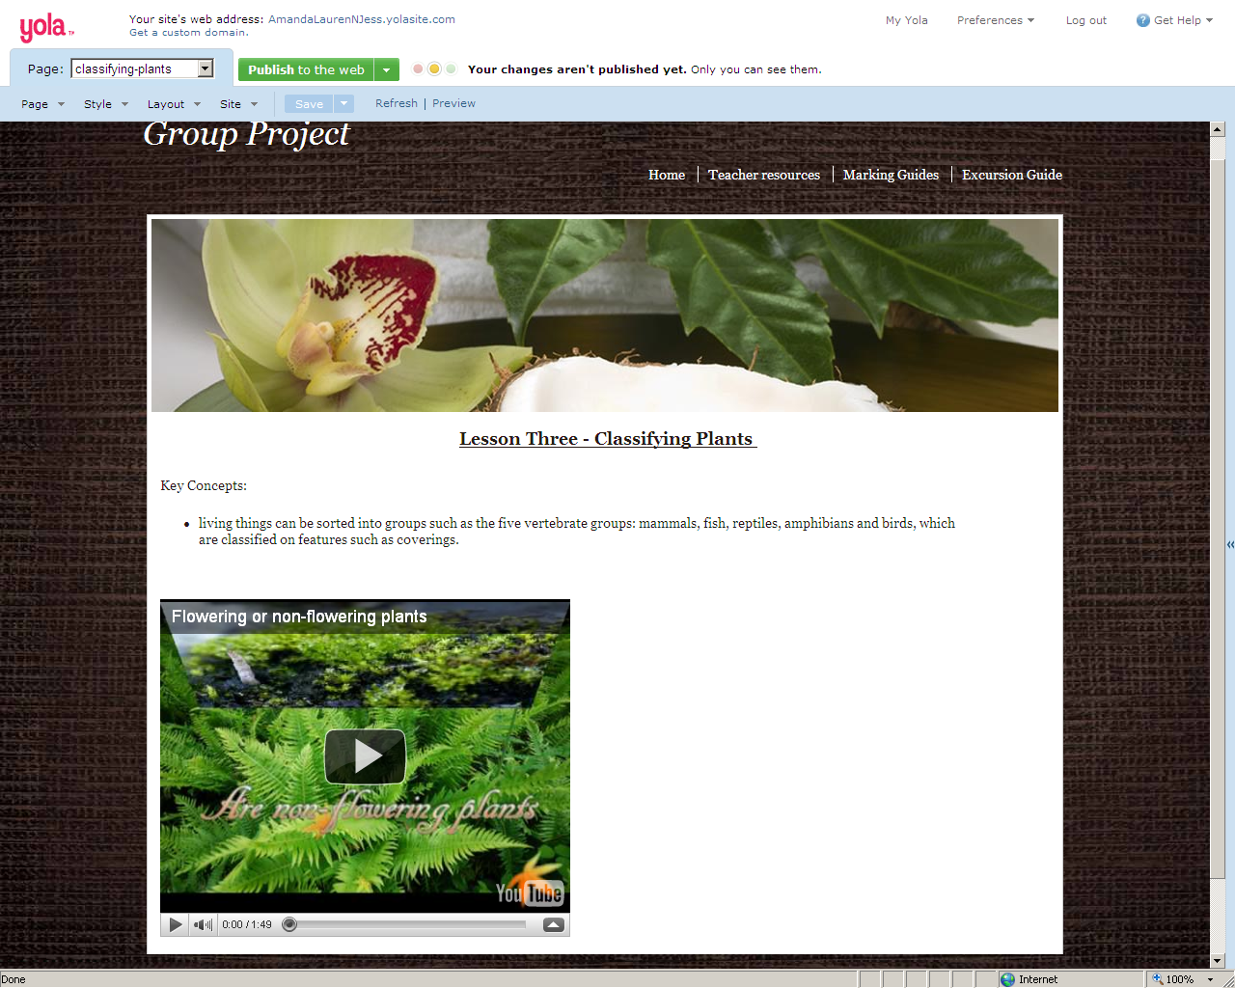

Slide 9


Slide 10
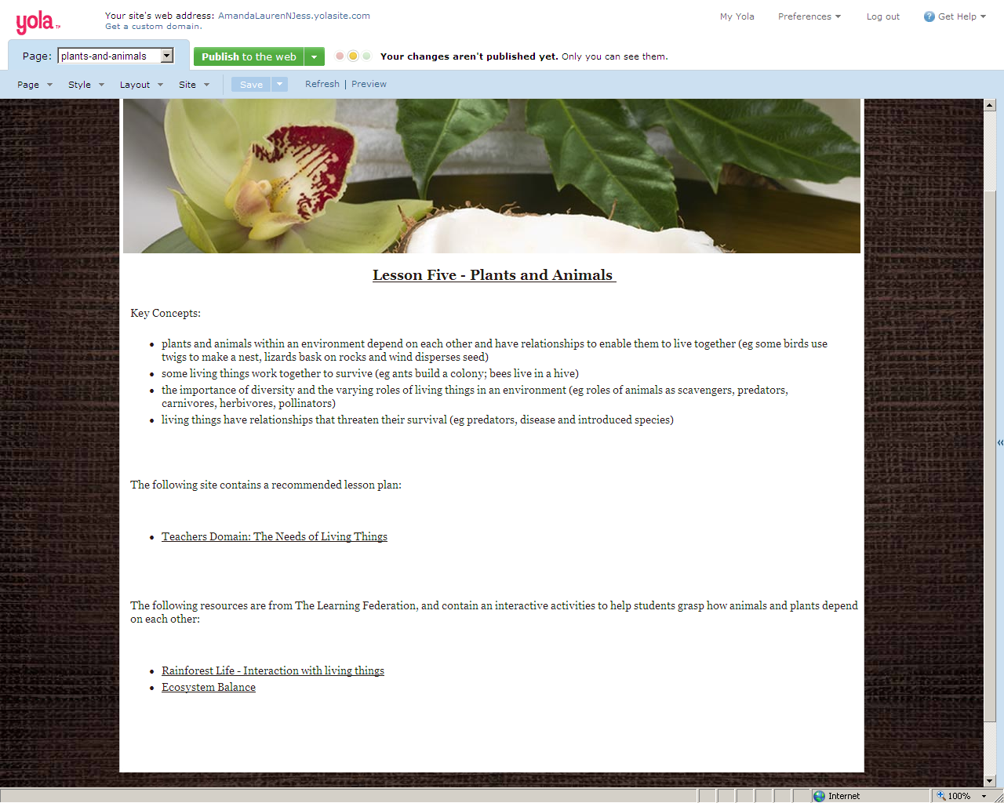

Slide 11
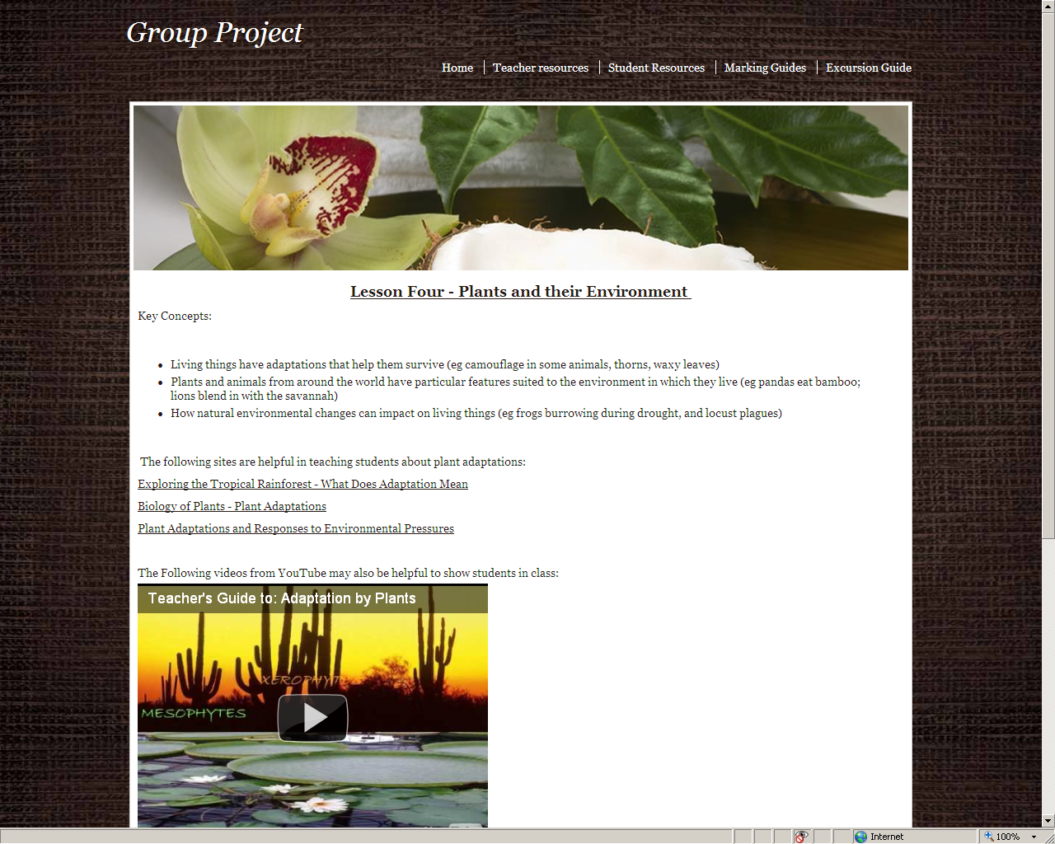

Slide 12
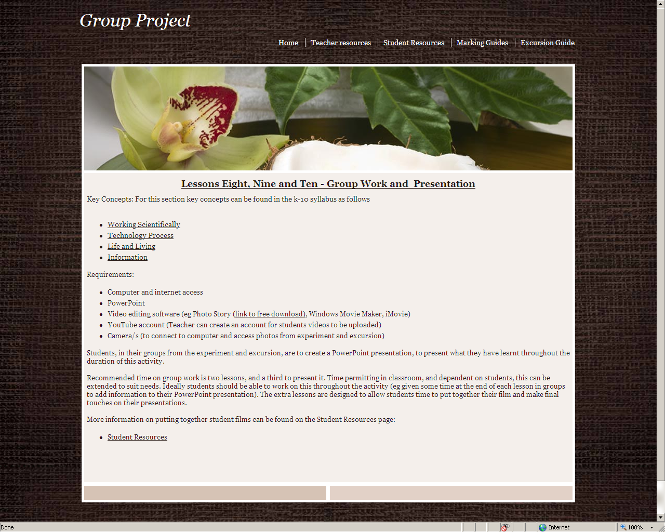

Slide 13
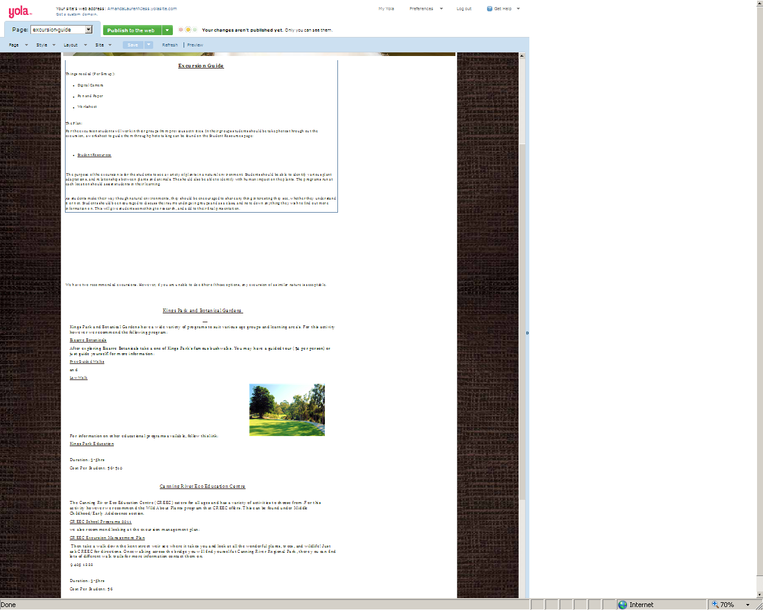

Slide 14



Slide 15




